Slide 1
Custom components pt 5 – templates & slots
Encapsulated, single-responsibility, reusable code

Slide 2

Contents
What is a template?
Why do we need it?
How to use it?
What is a slot?
How do we use it?

Slide 3
What is a template?
The <template> tag is used as a container to hold some HTML content hidden from the user when the page loads. The content inside <template> can be rendered later with a JavaScript.

Slide 4
Template example index.html
template with template id
…
<body>
<div id="app"></div>
<script type="module" src="/main.js"></script> </body>
<template id="template-counter-template">
<h1>TemplateCounter</h1>
<div><span id="counter-div"></span></div>
</template>
</html>
template content
template will NOT be rendered in the page!

Slide 5
Template example template-counter.js
find the template in the document using the template id
connectedCallback() {
this.value = this.DEFAULT_VALUE;
// Clone the template and append to the shadow root
const template = document.querySelector("#template-counter-template")
const node = template.content.cloneNode(true);
this._shadowRoot = this.attachShadow({mode: 'open'});
this._shadowRoot.appendChild(node);
// Install the event listener
this._counterView = this._shadowRoot.querySelector('#counter-div’);
this._counterView.addEventListener('mousedown', this._updateCounter.bind(this));
// Call the render function
this.render();
}
clone the content of the template
append the cloned template content to the shadowRoot

Slide 6
Template example template-counter.js
connectedCallback() {
this.value = this.DEFAULT_VALUE;
// Clone the template and append to the shadow root
const template = document.querySelector("#template-counter-template")
const node = template.content.cloneNode(true);
this._shadowRoot = this.attachShadow({mode: 'open'});
this._shadowRoot.appendChild(node);
// Install the event listener
this._counterView = this._shadowRoot.querySelector('#counter-div’);
this._counterView.addEventListener('mousedown', this._updateCounter.bind(this));
// Call the render function
this.render();
}
But wait! Is this id unique?
Yes the shadow DOM makes ths possible!

Slide 7
What is a slot?
The <template> element makes it easier to create html code for custom components
Drawback is that the template needs to be defined inside the DOM
Please let us load html fragments!
You can use id’s in a <template> because of the shadow DOM
Normally you cannot!

Slide 8
Template example index.html – defing the slots
Here is our template again
<body>
<div id="app"></div>
<script type="module" src="/main.js"></script> </body>
<template id="template-counter-template2">
<slot name="title"></slot>
<span id="counter-div"></span>
<div>
<slot></slot>
</div>
</template>
</html>
This is a “named slot”
This is the “default slot” (there can be only one!)

Slide 9
Template example index.js – using the slots
use the custom component
<template-counter>
<span slot="title" >Slotted counter:</span>
<span >Text underneath</span>
</template-counter><br/>
<template-counter>
<span slot="title" class="my-slot-title">Styled Slotted counter:</span>
<span class="my-slot-text">Much smaller text underneath</span>
</template-counter>
Fill the named slot (referred by name)
Fill the default slot
You can add styling in slots!!!

Slide 10
Template example style.css – styling the slots
<template-counter>
<span slot="title" >Slotted counter:</span>
<span >Text underneath</span>
</template-counter><br/>
<template-counter>
<span slot="title" class="my-slot-title">Styled Slotted counter:</span>
<span class="my-slot-text">Much smaller text underneath</span>
</template-counter>
This CSS is “outside” the component!
create some CSS for the slots
.my-slot-title {
background-color: #646cff;
color: white;
font-size: 1.5em;
padding: 4px;
border-radius: 8px;
}
.my-slot-text {
font-size: 0.5em;
font-style: italic;
color: #666666;
}

Slide 11
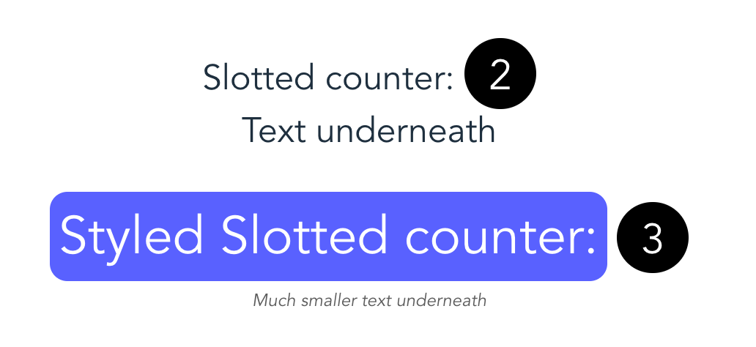
Template example browser output
Rendered component (without styling)
Rendered component with (slot) styling
This CSS in the slots is defined “outside” the component!

Slide 12
The Shadow barrier
Slots are part of the component
Light DOM
Shadow DOM
<html>
<html>
<slot>
<html>
<slot>
<html>
But are part of the Light DOM

Slide 13
The Shadow barrier
Slots fall in the Light DOM
But the CSS elements
:root
html
body
Also work on both the Light and Shadow DOM!

Slide 14
Conclusion
The <template> element makes it easier to create html code for custom components
Drawback is that the template needs to be defined inside the DOM
Please let us load html fragments!
You can use id’s in a <template> because of the shadow DOM
Normally you cannot!
The <slot> element makes it possible to ‘inject’ html & CSS into an component

